Slide 1

Lightweight Reversible
Data Perturbation
for Privacy Preservation in IIoT Modbus Systems
Progress Report
Rabbi Hasan Himel | Tayyaba Basri | Hamza Haroon
Supervisor: Doç. Dr. Emrullah Fatih Yetkin
Notes:
1

Slide 2
Problem & Motivation
IIoT sensor data transmitted to cloud in plaintext
Intercepted data can reveal how the factory operates.
Includes sensitive details like process settings and configurations.
Existing solutions (AES, TLS, HE) add latency unacceptable for real-time
The Problem
Our Goal
To measure and compare the accuracy and privacy loss caused by each purturbation method.
To apply multiple purturbation methods such as XOR and Gaussian noise on the same dataset
Enable safe public dataset release for cybersecurity research
Compare Gaussian noise and XOR 16 and 64 bits
Notes:
3

Slide 3
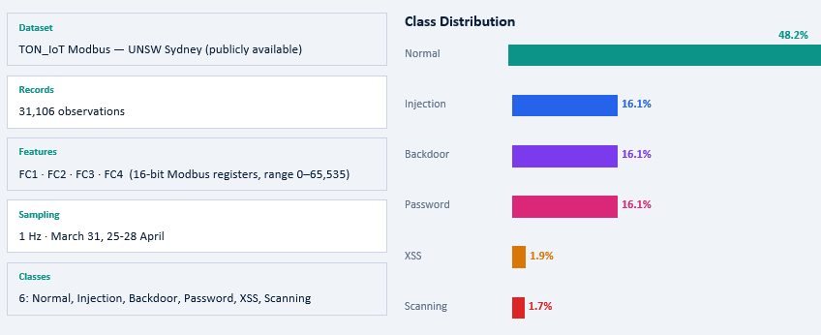
Dataset: TON_IoT Modbus
Notes:
6

Slide 4
Our Approach: XOR-Based RDP
Factory / Edge
Attacker (MitM)
Trusted Cloud
Intercepts encrypted stream
Sees uniform noise
pure random guessing
Regenerates same key
stream from shared seed
XOR reversal → 100%
perfect data recovery
Can publish restored data
for research use
Applies XOR with PRNG
key stream (seed=999)
Data scrambled before
cloud transmission
Original registers become
statistically random
encrypt: XOR(data, key) → noise | decrypt: XOR(noise, key) → data
Notes:
4

Slide 5
Implementation Pipeline
XOR Encrypt / Decrypt - 16 bit
XOR Encrypt / Decrypt - 64 bit
Load Modbus data
Generate key stream from seed 999
XOR encrypt FC1–FC4 registers combined
Save encrypted CSV
XOR decrypt using same seed
Verify: 0 max error, 100% match
XOR with 64 bits
FC1 = 49389 → 1100000011101101
FC2 = 52921 → 1100111010111001
FC3 = 25770 → 0110010010101010
FC4 = 13625 → 0011010100111001
1100000011101101 1100111010111001 0110010010101010 0011010100111001
Load Modbus data
Generate key stream from seed 999
XOR encrypt FC1–FC4 registers seperately
Save encrypted CSV
XOR decrypt using same seed
Verify: 0 max error, 100% match
Notes:
5

Slide 6
Implementation Pipeline
Gaussian Encrypt / Decrypt
Analysis Pipeline
Load original CSV
noise multiplier = 0.8
Compute σ = 0.8 × data std
Add Gaussian noise N(0, σ)
Save encrypted CSV
Subtract noise for decryption
Verify: residual error (NOT perfect)
88% decrypt
At this stage it can easily get cracked
Load 3 CSV files
Descriptive stats (mean, std, skew, kurtosis)
Distribution + stationarity + ACF
FFT + Welch PSD spectral analysis
RF classifier → accuracy, F1, confusion matrix
Multi-class attack detection
Notes:
5

Slide 7
Computational Performance
Measured in nb1 and nb2 — proves the 'lightweight' claim
<1 ms
<1 ms
~1 ms
0 errors
XOR Encryption
31,106 rows
XOR Decryption
31,106 rows
Gaussian Encryption
31,106 rows
XOR Restoration
Max Error
Why this matters for IIoT deployment
XOR is a single CPU instruction — processes 31K records in under 1 millisecond
Suitable for resource-constrained PLCs and edge devices (no cryptographic coprocessor needed)
AES-128 requires ~10-100× more computation per record — benchmarks coming in Phase 2
Sub-microsecond per-sample latency makes real-time SCADA protection feasible
Time per sample: XOR ≈ 0.03 µs | Gaussian ≈ 0.03 µs | AES-128 ≈ 1–5 µs (to be benchmarked)
Notes:
10

Slide 8
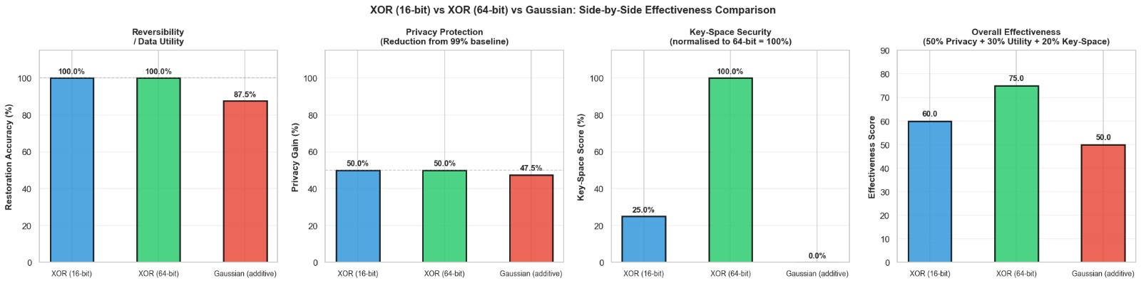
XOR (16 bit) vs XOR (64 bit) vs Gaussian: Side-by-Side Effectiveness Comparison

Slide 9
XOR (16 bit) vs XOR (64 bit) vs Gaussian: Side-by-Side Effectiveness Comparison

Slide 10
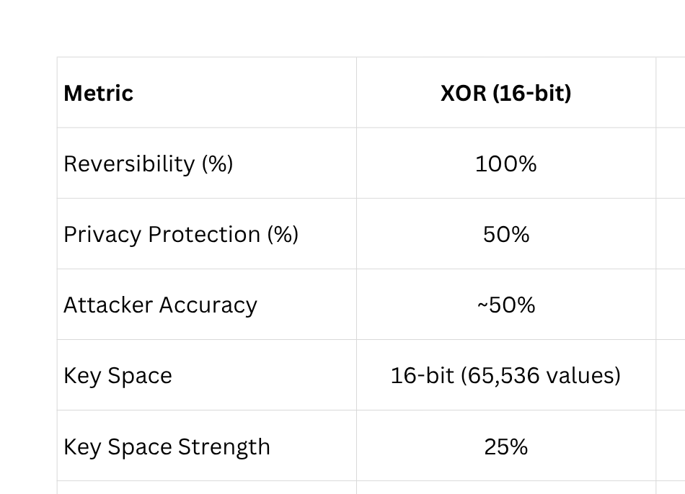
Encryption Method Comparison
Notes:
7

Slide 11
What We Plan to achieve in future
Explore combining Gaussian noise with CRC32/HMAC hashing
Investigate Laplace noise as an alternative to Gaussian for better privacy preservation
Explore quantization techniques
Study the impact of IEEE 754 floating-point representation, especially modifying the most significant bits
Notes:
13

Slide 12
Thank You
Notes:
16

